Slide 1
Capstone Project - The Battle of the Neighborhoods

Slide 2
Table of Contents
1. Introduction
2. Business Problem
3. Data
4. Methodology
5. Results
6. Discussions
7. Conclusion

Slide 3
Introduction
The City of New York, is the most populous city in the United States. It is diverse and is the financial capital of USA. It is multicultural. It provides lot of business opportunities and business friendly environment. It has attracted many different players into the market. It is a global hub of business and commerce. The city is a major center for banking and finance, retailing, world trade, transportation, tourism, real estate, new media, traditional media, advertising, legal services, accountancy, insurance, theater, fashion, and the arts in the United States. This also means that the market is highly competitive. As it is highly developed city so cost of doing business is also one of the highest. Thus, any new business venture or expansion needs to be analyzed carefully. The insights derived from analysis will give good understanding of the business environment which help in strategically targeting the market. This will help in reduction of risk. And the Return on Investment will be reasonable.

Slide 4
Business Problem
The City of New York is famous for its amazing cuisine. Its food culture includes an array of international cuisines influenced by the city's immigrant history. Thai restaurants have become so popular in the United States now it seems that there is one on every corner, not only in major cities but also in smaller cities. Starting a Thai restaurant can be a great business opportunity, but you need to distinguish yourself from others to enjoy long-term success.
If you plan a real restaurant that can demand higher prices for fresh sea food, focus on neighborhoods and outlets that already attract sophisticated Thai clients. If you plan a cheap buffet restaurant, points to the masses looking for affordable high-traffic locations with large shopping centers and other local points of interest.
The stakeholder wants to open his business in Manhattan area, so I focus on that borough during my analysis. We define potential neighborhood based on the number of Thai restaurants which are operating right in each neighborhood. Manhattan has full potential but also is a very challenging district to open a business because of high competition. New Thai restaurant should be opened in an area where the it can attract more customers. Therefore, in this analysis it is necessary to ensure that we have enough customers and that we are also close to other Thai outlets so that we get a good turnover of Thai food lovers.

Slide 5
Data
1: New York has a total of 5 boroughs and 306 neighborhoods. In order to segment the neighborhoods and explore them, we will essentially need a dataset that contains the 5 boroughs and the neighborhoods that exist in each borough as well as the latitude and longitude coordinates of each neighborhood. This dataset exists for free on the web. Link to the dataset is:
https://geo.nyu.edu/catalog/nyu_2451_34572

Slide 6
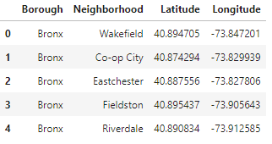
DATASET

Slide 7
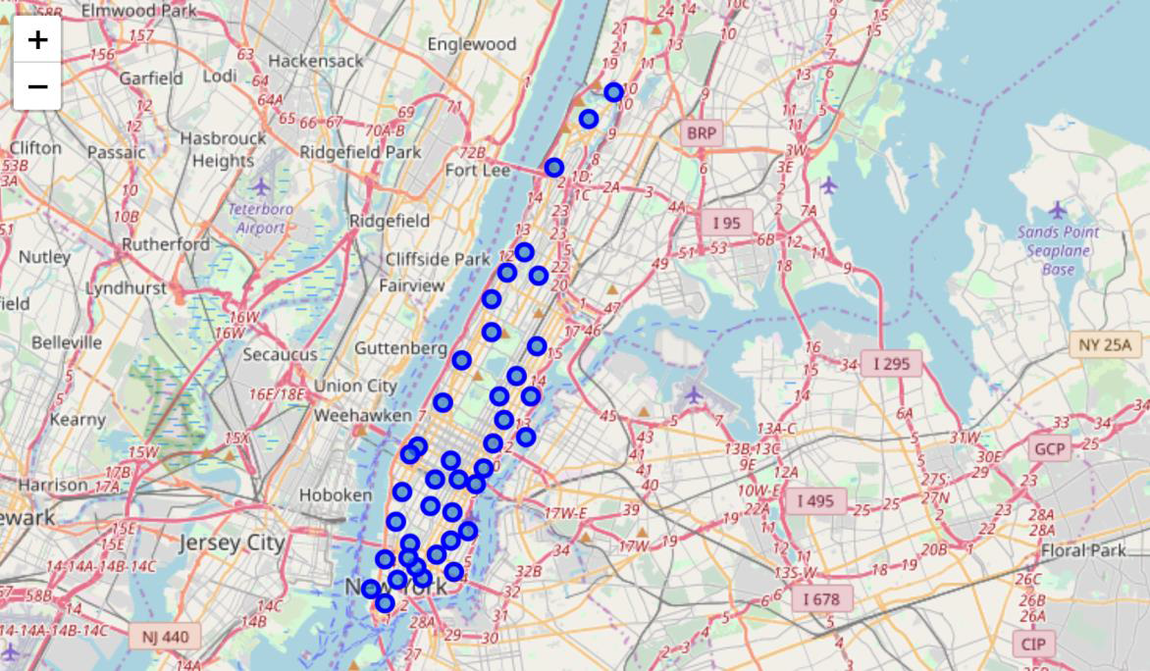
2: New York City’s geographical coordinates data will be utilized as input for the Foursquare API, that will be leveraged to provision venues information for each neighborhood. We will use the Foursquare API to explore neighborhoods in New York City. The below is image of the Foursquare API data.
In addition, Thai Category Id 4bf58dd8d48988d1d2941735 is used for retrieving data from Foursquare API.
The below map shows all the neighborhoods of New York City. The blue circle roughly covers Manhattan.

Slide 8
Methodology
The idea is to gather as much information as possible regarding Thai restaurants in New York City and try to categorize them based on their individual similarity. We converted addresses into their equivalent latitude and longitude values. Then we used the Foursquare API to explore neighborhoods in Manhattan, New York. After that, we called an explore function to get Thai restaurant categories in each neighborhood.

Slide 9
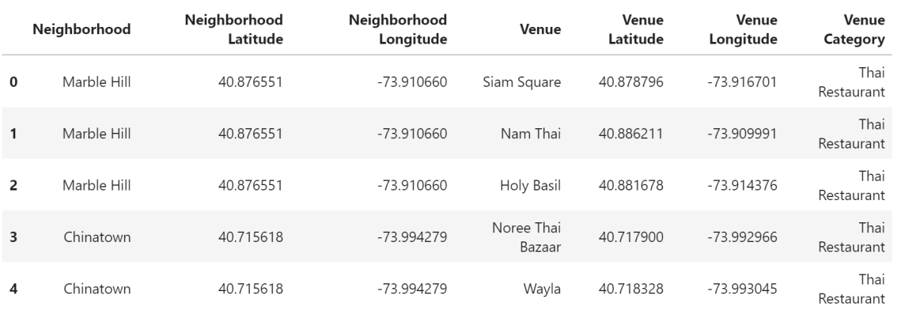

Slide 10
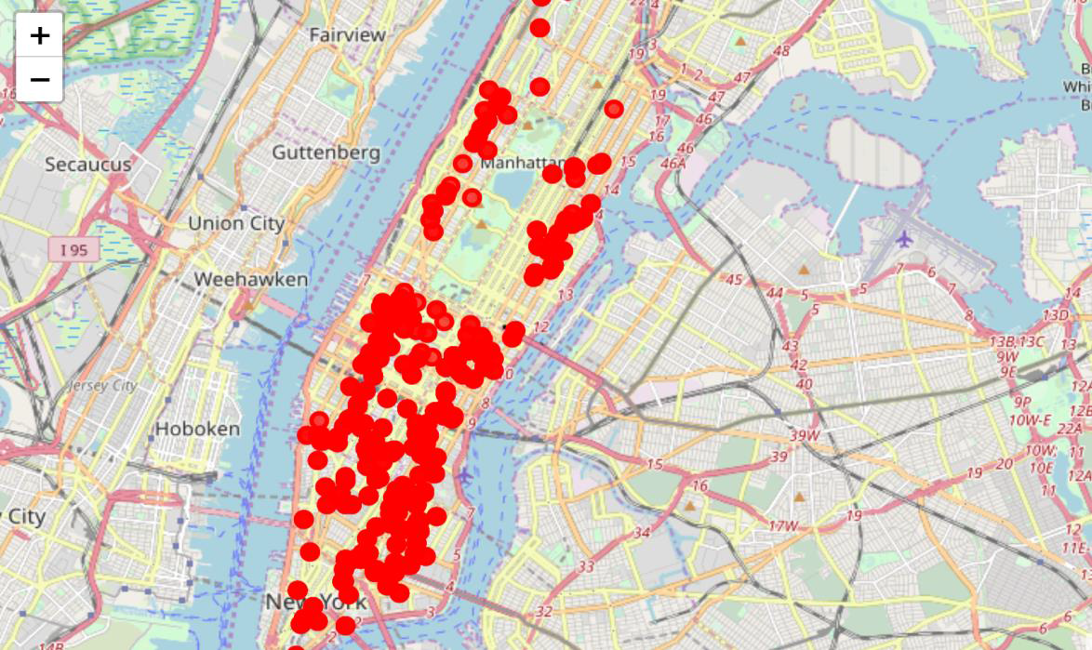
The below map shows the various locations of Thai restaurant outlets in New York. From the dispersed distribution near Manhattan, we can see that the frequency of Thai restaurants here are quite low compared to the south of the city.

Slide 11
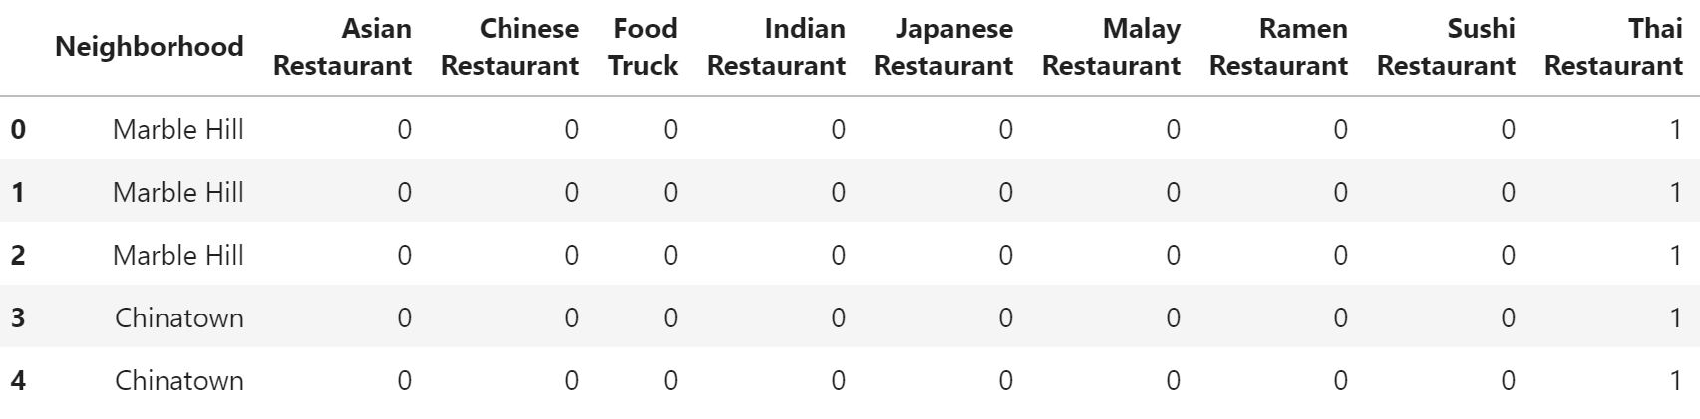
Thai restaurants in Manhattan

Slide 12
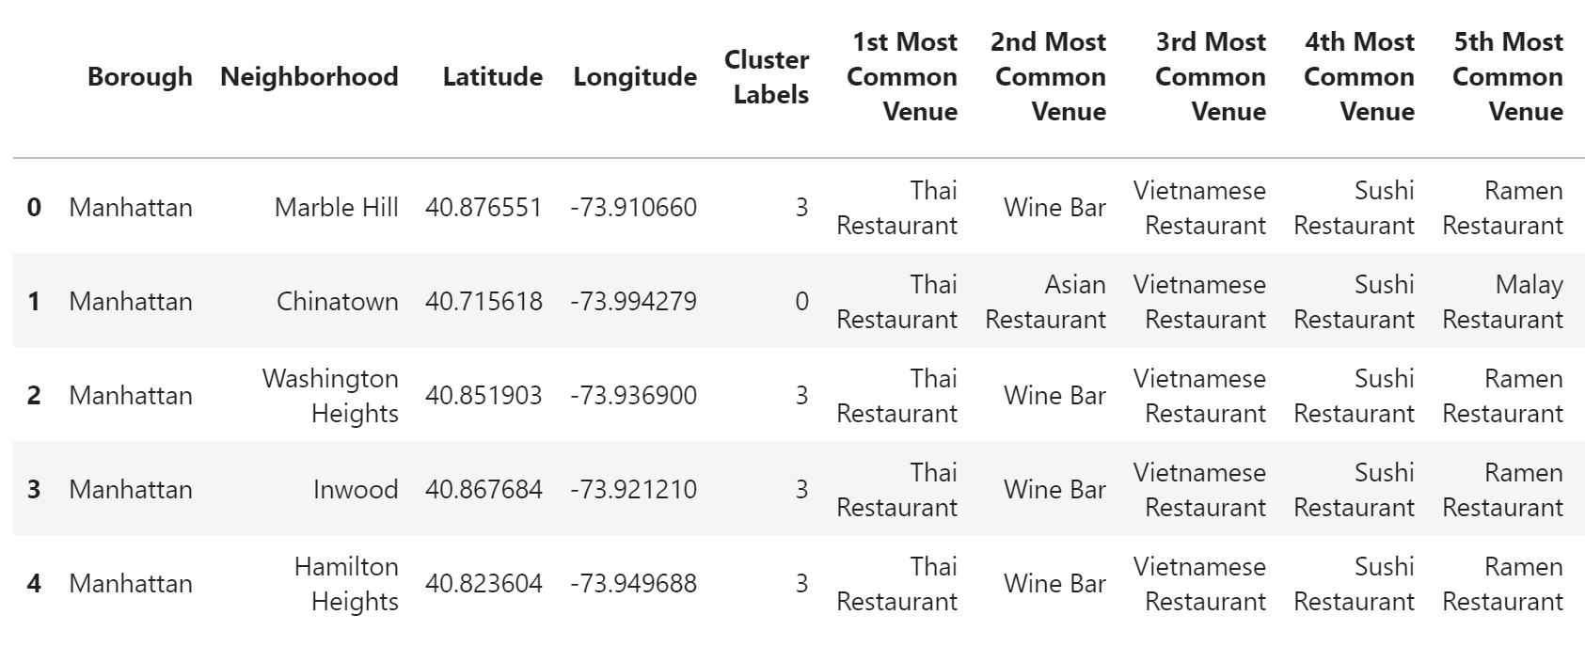
Then use this feature to group the neighborhoods into clusters. K-means clustering algorithm was used to cluster the restaurants. And also, the Folium library to visualize the neighborhoods in Manhattan and its emerging clusters.

Slide 13
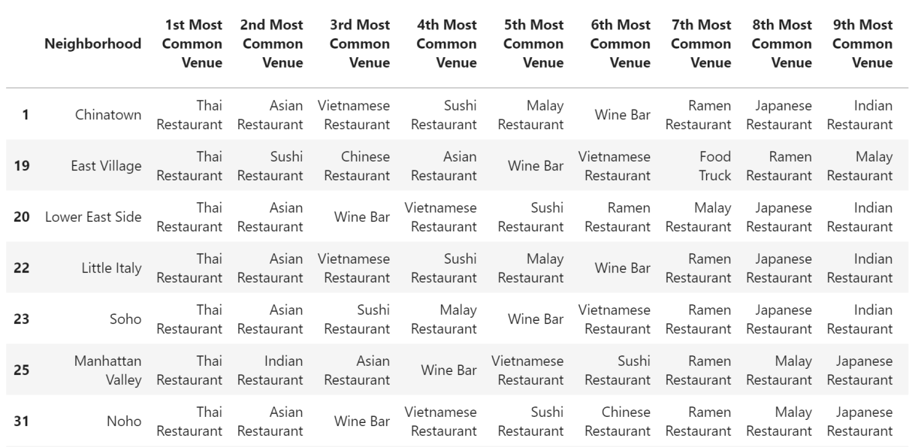
Results
Cluster 0

Slide 14
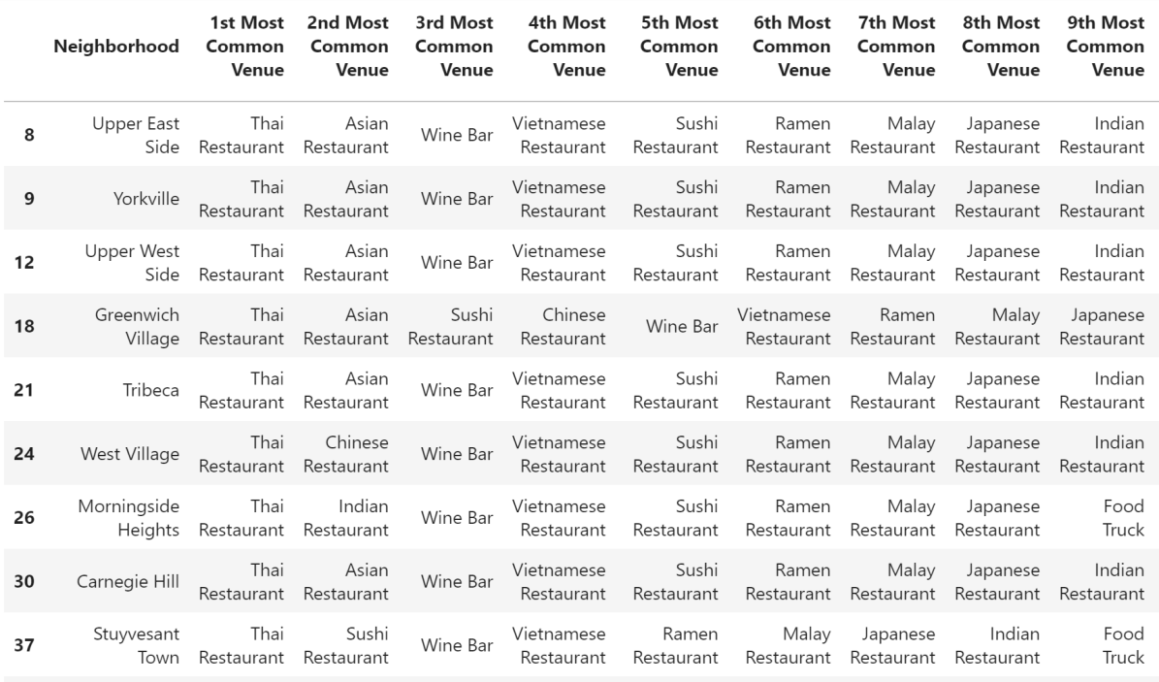
Cluster 1

Slide 15
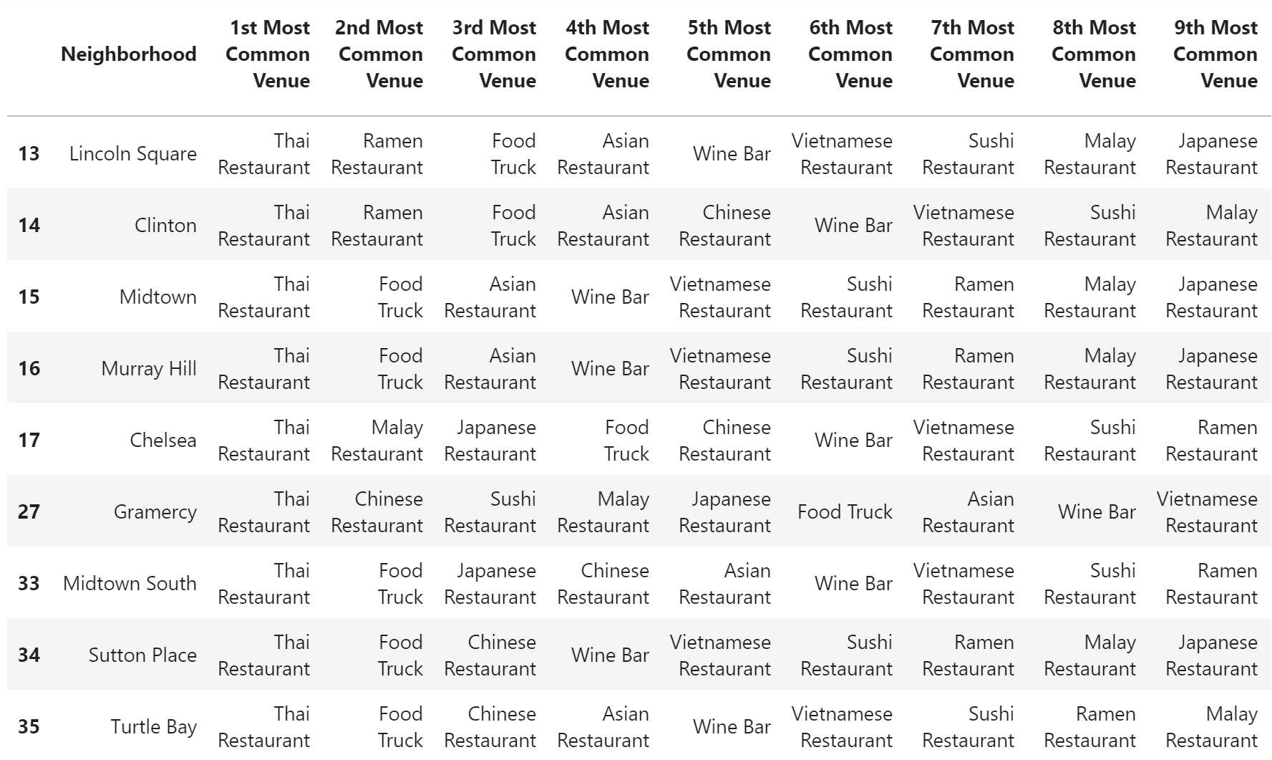
Cluster 2

Slide 16
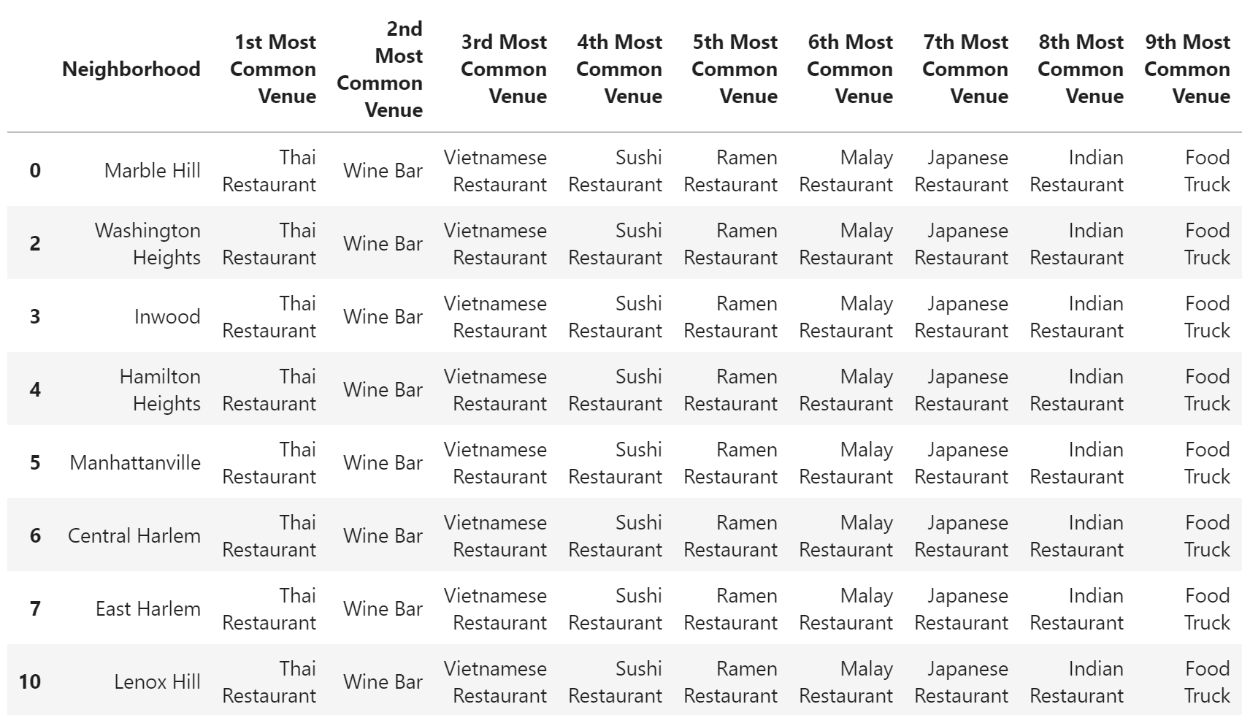
Cluster 3

Slide 17
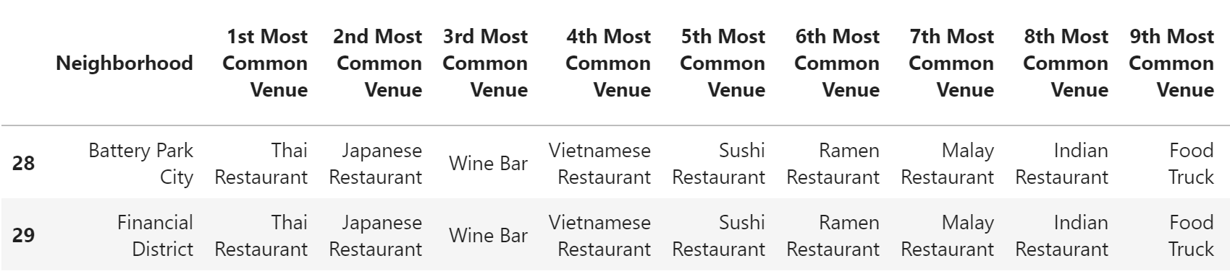
Cluster 4

Slide 18
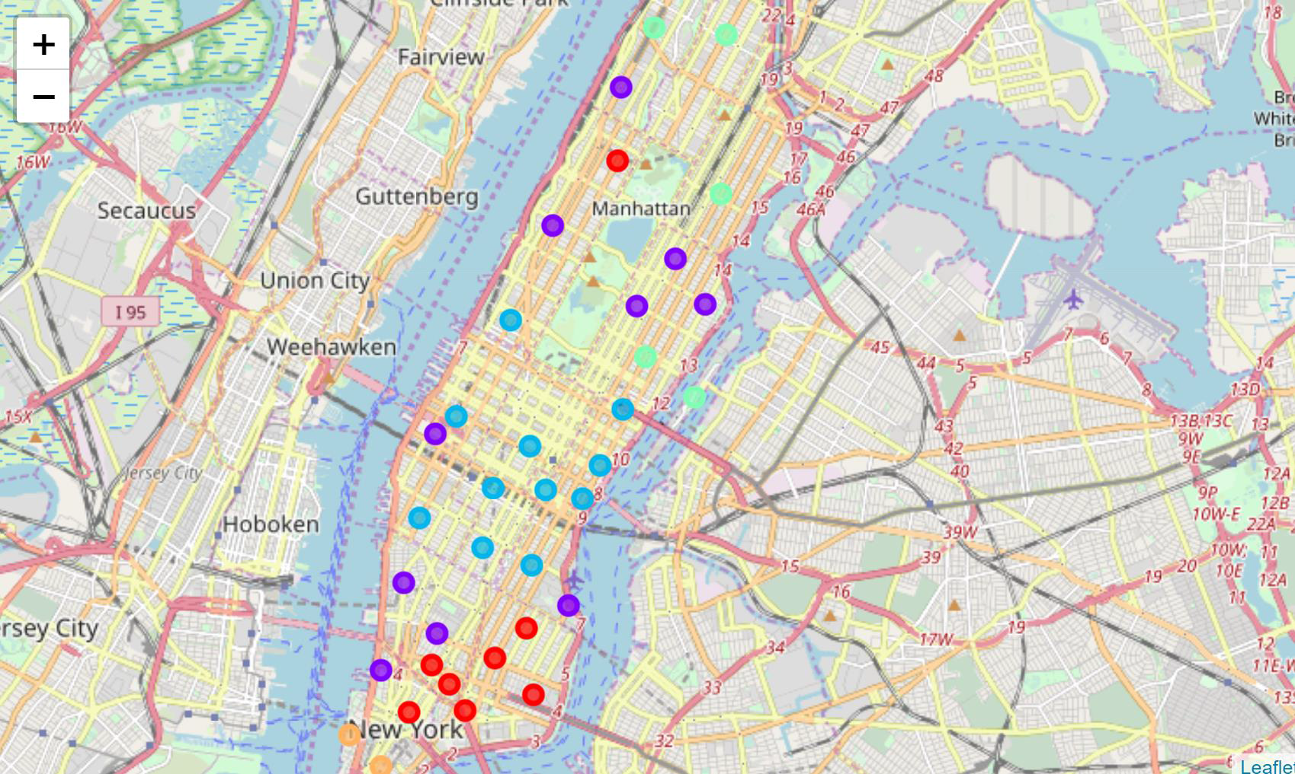
Cluster map

Slide 19
Result
After studying the cluster data from the dataframes and reviewing the cluster map, we come to the conclusion that most optimum area to open a new Thai Restaurant would be near Yorkville and Carnegie north of Upper East Side in Cluster 1.

Slide 20
Discussion
In this section, I would be discussing the observations I have noted and the recommendation that I can make based on the results.
This analysis is performed on limited data. Most optimum results may vary based on input parameters and also the initial cluster value input.
Also, few key highlights:
• Washington Heights would be least favorable location to open a Thai restaurant pertaining to the sparsity in the region which may be as a result of people’s preferences.
• More detailed analysis can be done and better results can be achieved by considering other factors such as transportation, demographics of inhabitants

Slide 21
Conclusion
Although all of the goals of this project were met, there is definitely room for further improvement and development. However, this analysis can be used as a dependable guideline for any stakeholder planning to venture having this use case.
As per the neighborhood or restaurant type mentioned, this analysis can be referred to. A venue with lowest risk and competition can be identified.
The location parameters can be tweaked to match any requirements around the world provided proper location specific data is present.

